Slide 1
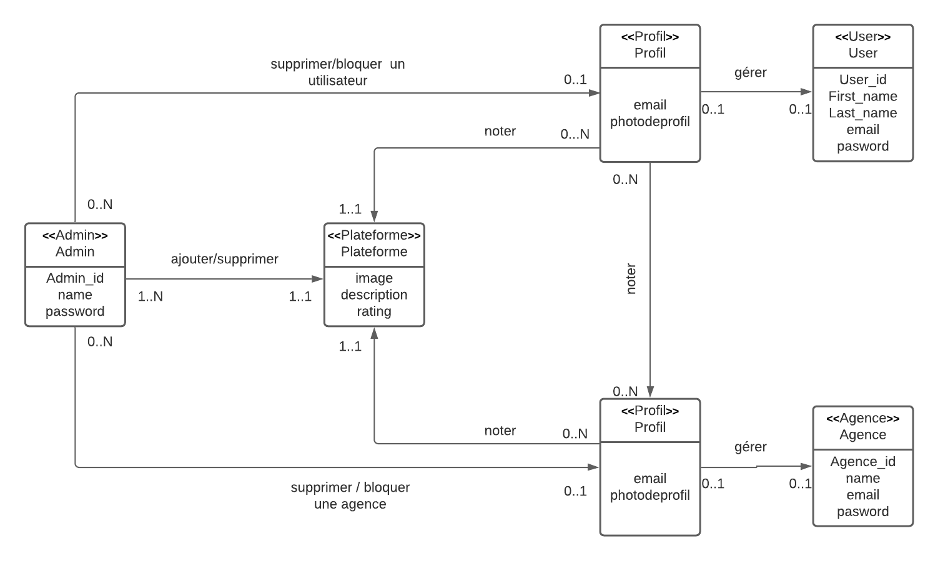
Diagramme de classe:

Slide 2
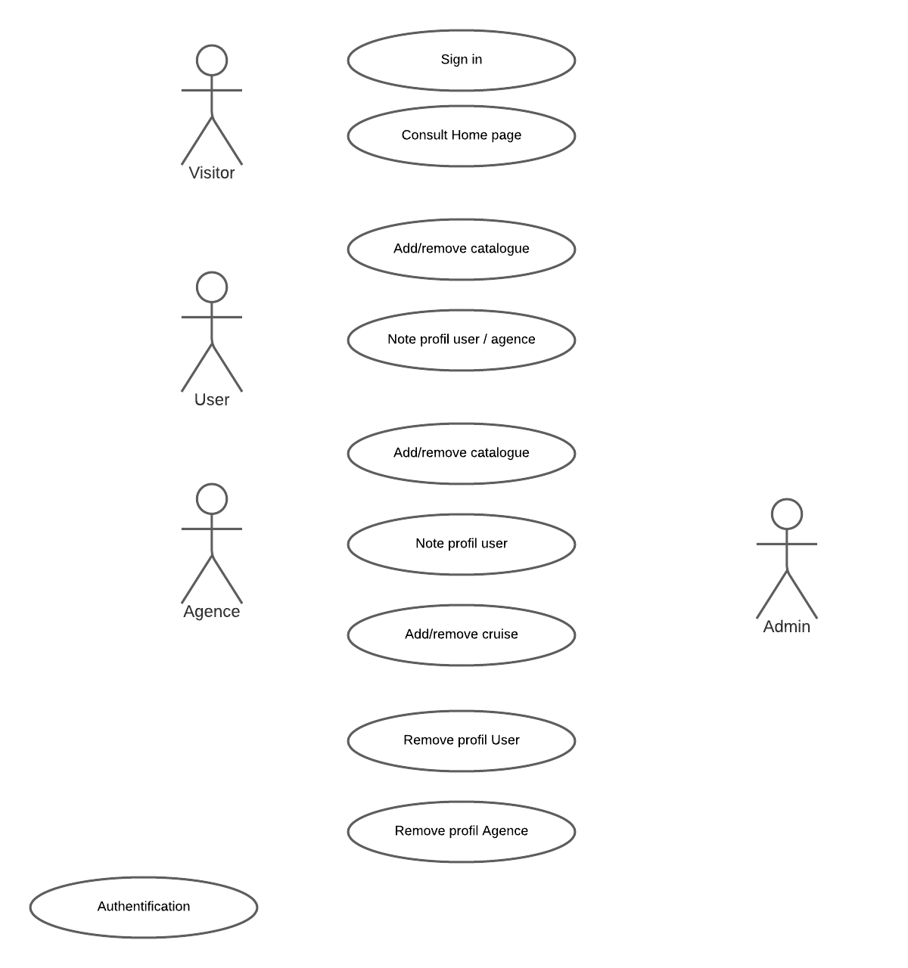
<include>
<include>
<include>
<include>
<include>
<include>
<include>

Slide 3
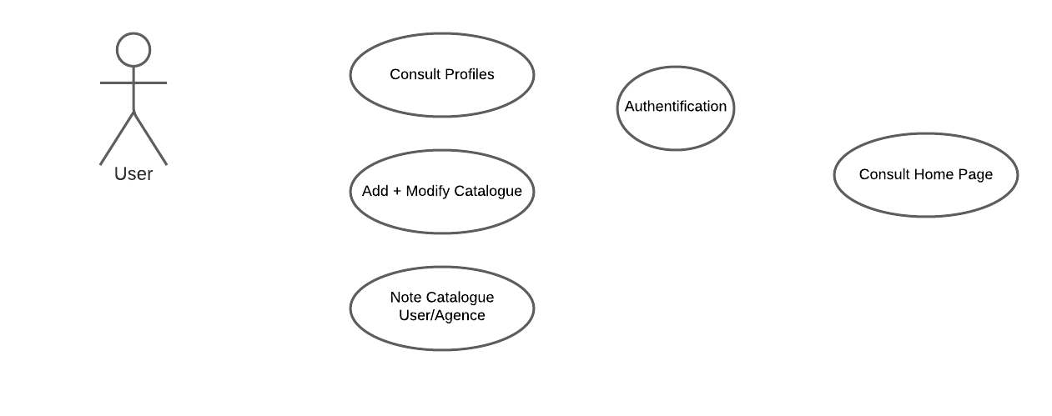

Slide 4
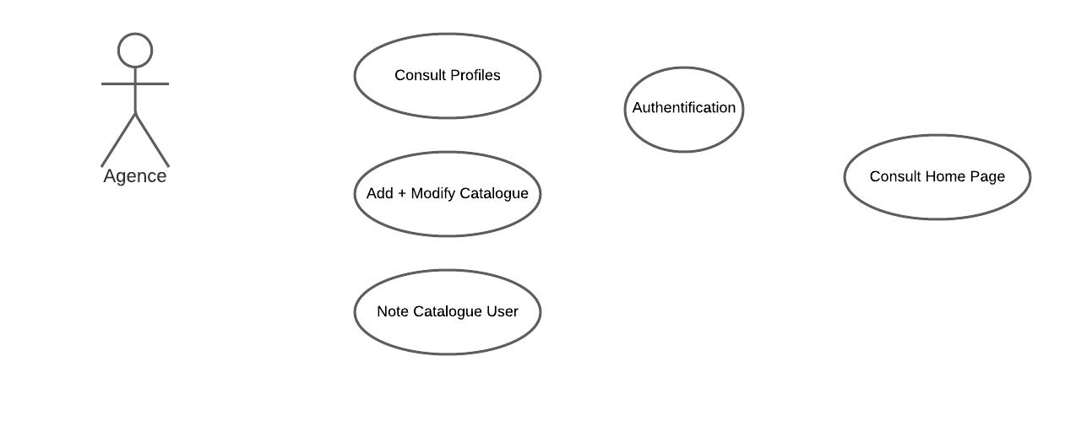

Slide 5
ok
Home page
NAVBAR
Logo+Nom
Top destinations
Top agences
Sidebar
Images de qlq destinations
Login
Dropdown
Destination ……
Rating……
rechercher
Signin
Top 10 Destinations
Contact us
image
image
image
Rating
Rating
Rating
Description
Description
Description
Top agences
Qui sommes nous?
footer

Slide 6
Sign in
ok
First Name *
Last Name *
First Name…
Last Name…
Email address *
Password *
email…
password…
Confirm password *
Confirm password…
Sign in
cancel

Slide 7
Sign in
ok
Email address *
email…
Password *
password…
Forgetten password?
Login
cancel

Slide 8
Contact us
NAVBAR
Logo+Nom
Top destinations
Top agences
Sidebar
Welcome to our app , …………………………………………………………………………………..
Login
Name
Name…
Signin
Email
Contact us
email…
Subject
Write something…
Message
send

Slide 9

NAVBAR
User Account
search……
rechercher
View agences
image
image
image
Full Name User
Log out
Rating
Rating
Rating
Description
Description
Description
image
Rating
Description
Sidebar

Slide 10
NAVBAR
Agence Account
search……
rechercher
Croisières
offres
image
image
image
Agence name
Log out
Rating
Rating
Rating
Description
Description
Description
image
Rating
Description
Sidebar

Slide 11

Site Administrator
Remove/ Bloc User
Remove/ Bloc agence

